Slide 1
Design and Implementation of a Hospital Database Management System (HDMS) for Medical Doctors
A James C., A. Valerian C., and N. Sixtus E

Slide 2
I. Introduction

Slide 3

Hospitals are one of the most principle institutions in a society and it is absolutely necessary that they are operated in the most efficient manner
Therefore, there is need for a system that will make this possible.

Slide 4
Need and Functions Provided in the Hospital Database Management System
For Doctors and Nurses | For patients | For administration
Accessing patient information Arranging doctors’ and nurses’ schedules Accessing lab results | Accessing their diagnostic information Accessing their prescriptions | Accessing hospital stats like, patient capacity, employee details Maintaining accounts

Slide 5
II. Sources of data

Slide 6
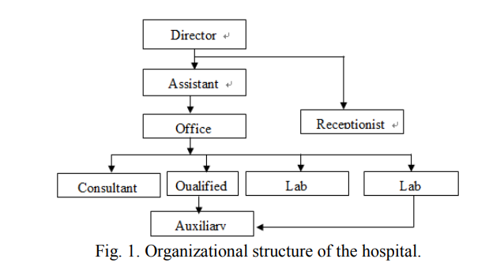
II. Sources of data
Observation Method
Documentation and Events in the hospitals
Information from published sources
Interview
Organizational Structure of the Hospital

Slide 7
III. Method of Keeping Record - Manual

Slide 8
III. Method of Keeping Record - Manual
Problems with this method:
Highly inefficient to retrieve
Difficult to make changes and updations
Easy to have errors
Not cost efficient
Security issues

Slide 9
IV. SYSTEM PROPOSAL

Slide 10
IV. SYSTEM PROPOSAL/PROPOSAL OF NEW SYSTEM
Expected functionalities of the database management system:
To fully automate the operation of the hospital and managerial system in the hospital.
To achieve good computing skills for the management and staff of the hospital.
To improve the accurate record keeping in the hospital
To provide timely access to patients and personnel records.

Slide 11
IV. SYSTEM PROPOSAL/PROPOSAL OF NEW SYSTEM
System will have the following modules:
The Administrative module
The Receptionist module
The Medical Doctor Module
The pharmacy Module
The Nurse Module
The Lab-Technologist module
The Account module

Slide 12
V. Program Structure

Slide 13
Overview:
Hospital database application runs in a web browser
Username and password are necessary
It is designed to make use of e-mail addresses for username field.
If you have a successful login process, the application will enable a hyperlink that assigns duties based on user role.

Slide 14
System and Software Requirement:
This includes the software and the hardware that make the package being developed to run effectively.
Requires networking devices that will enable connection within a Local Area Network (LAN).
Server side: | Client side:
Window Apache MySQL PHP (WAMP) | Web Browser

Slide 15
Hardware Requirement
IBM Intel or Microsoft compatible computers
A hard disk capacity of at least 2 GB
random access Memory (RAM) size at least 64MB
A switch that connects all the client computers to the server, and network cables that connect all the hospital units to the server.

Slide 16
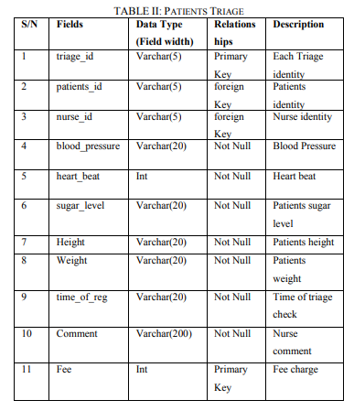
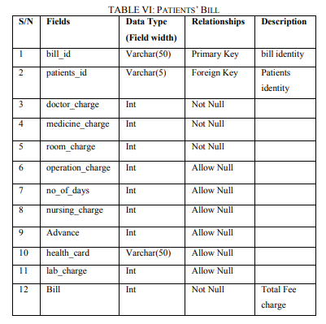

Slide 17
The System Development Process
System developed using system development life cycle (SDLC)
Pre existing system was identified and defined
Then, the problems and setbacks were identified and a solution is put into place

Slide 18
After System is Made
A. Testing and Evaluation
B. System Change Over
C. System Maintenance

Slide 19
VII. CONCLUSION

Slide 20
VIII. CONCLUSION
The database system has been created and is fully functional in the Our Lady of Mercy hospital
The software has been designed to include program modules to handle the Medical Centre information
Modifications are made according to requirement periodically
Thus, resulting in a compatible, accurate, flexible, secured and efficient system.

Slide 21
Bibliography
C., Amaechi & C., Agbasonu & Nwawudu, Sixtus Ezenwa. (2018). Design and Implementation of a Hospital Database Management System (HDMS) for Medical Doctors. International Journal of Computer Theory and Engineering. 10. 1-6. 10.7763/IJCTE.2018.V10.1190.

Slide 22
Implementation Plan
Database will be created, this will contain the tables shown in the paper.
Website will be created where the user can enter whether they are doctor, patient, nurse, etc.
They will have to login with a username and password to access information

